Slide 1
Social Media Engagement Analysis
- PRATIKSHA PRAMOD SARAF

Slide 2

Introduction
Instagram is a photo and video sharing platform owned by Meta, where users post photos, like, comment and follow each other, and every action creates valuable data. The Marketing team wants to use this data to build targeted strategies that increase user engagement, retention and acquisition. This project uses SQL to analyse Instagram’s database of users, photos, comments, likes, follows and tags. It then turns the results into clear insights and practical marketing recommendations.

Slide 3
Objectives & Problem Statement
Meta’s Marketing team has a large amount of Instagram user data but no clear view of who its loyal users are, who is inactive, and what drives engagement. Without these insights, it is hard to build targeted strategies that improve engagement, retention and acquisition.
Objectives :
Identify the most loyal users (oldest accounts) to reward and retain.
Find inactive users who have never posted, to re-engage them.
Find the most-liked photo to run a contest and boost engagement.
Find the most used hashtags to guide campaign content.
Find the best day for sign-ups to schedule ad campaigns and acquire users.
Detect suspected bot accounts to protect the quality of engagement.

Slide 4
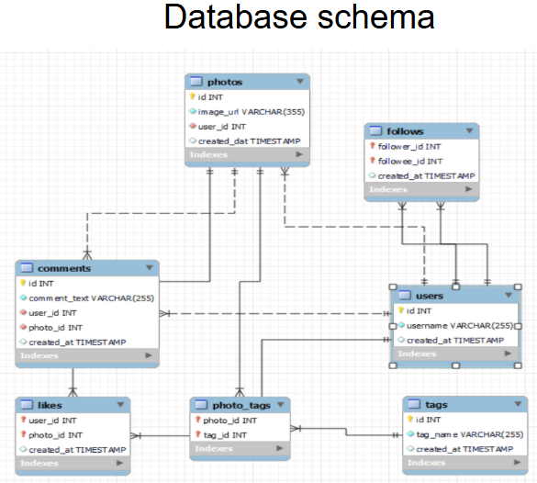
Data Overview

Slide 5
Methodology
1. Data Import
The Instagram database was imported into MySQL.
It contains 7 tables: users, photos, comments, likes, follows, tags and photo_tags.
2. Data Checking
Every table was checked for null values and duplicate records.
None were found, so the data was clean and no cleaning was needed.
3. Understanding the Schema
The relationships between tables were studied using primary and foreign keys.
For example, users link to photos, likes and comments through user_id.
4. Data Analysis using SQL
Basic queries: SELECT, WHERE, ORDER BY and LIMIT were used to explore the data and find top results.
Advanced queries: JOINs, GROUP BY, HAVING and subqueries were used to combine tables and answer each objective.
Functions: COUNT and DAYNAME were used to count activity and find patterns by day.
5. Insights and Recommendations
The query results were interpreted to find patterns in user behaviour.
These were turned into marketing recommendations to improve engagement, retention and acquisition.

Slide 6
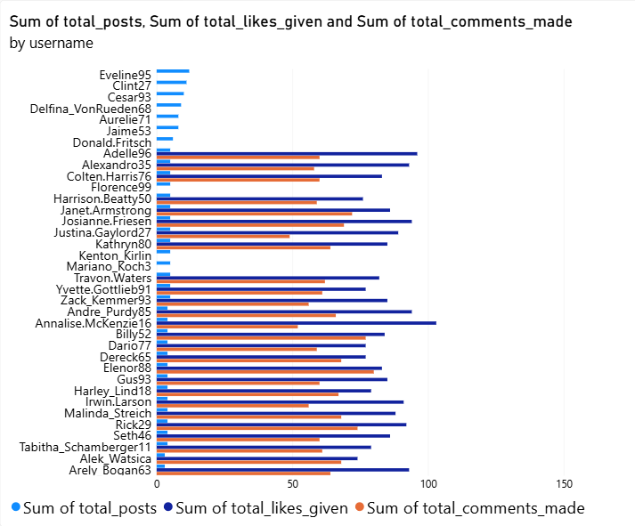
Analysis
User activity is unevenly distributed, with a small group of users showing significantly higher engagement.
Likes given are generally higher than comments made, indicating that users prefer quick interactions over commenting.
Several users demonstrate very low activity across posts, likes and comments.
Highly active users represent an opportunity to strengthen community engagement.
Recommendations :
Target inactive users: Send personalized notifications and content recommendations to encourage participation.
Reward active users: Introduce badges, recognition and loyalty rewards for consistent participation.
Personalize content: Recommend posts based on users' interests and previous interactions.

Slide 7
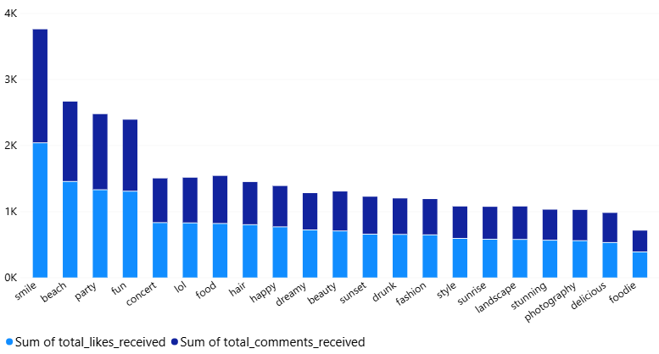
Analysis
The analysis shows that #smile has the highest engagement, followed by #beach, #party and #fun, indicating that these topics attract more user interactions. Hashtags such as #concert, #lol and #food also demonstrate strong engagement, while #foodie records the lowest engagement among the displayed hashtags. Overall, users interact more with certain content themes, highlighting the importance of understanding hashtag preferences when planning personalized advertising campaigns.
Recommendations
Prioritize popular hashtags: Use #smile, #beach, #party and #fun in relevant promotional campaigns.
Personalize advertisements: Recommend content based on users' hashtag interests and interaction history.
Optimize campaigns: Track likes and comments separately to understand how users respond to promotional content.

Slide 8
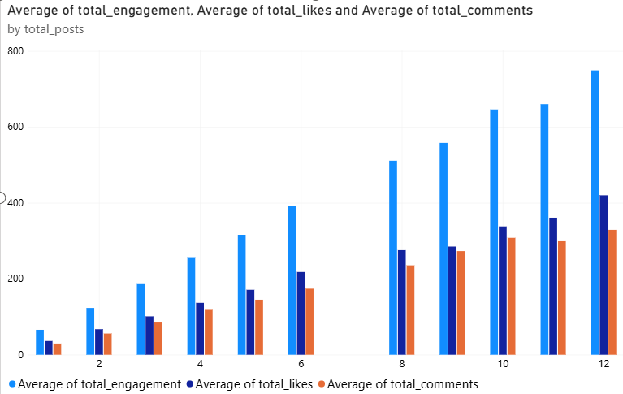
Analysis
Users with higher posting frequency generally show higher engagement. Users making 12 posts record the highest average engagement. Likes contribute more to interactions than comments.
Recommendation
Encourage consistent posting through challenges and reminders.
Recommend personalized content based on user interests.
Introduce interactive campaigns to increase comments.
Reward active users to encourage participation.

Slide 9
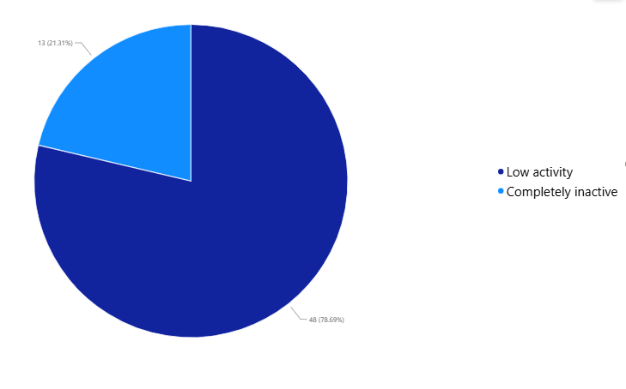
Analysis
48 users (78.69%) fall into the low-activity category.
13 users (21.31%) are completely inactive.
The majority of users show low engagement, indicating an opportunity to increase participation on the platform.
Recommendation
Encourage low-activity users to post more frequently through personalized content recommendations and notifications. For completely inactive users, use re-engagement campaigns and simple prompts to encourage them to return and interact with the platform.

Slide 10
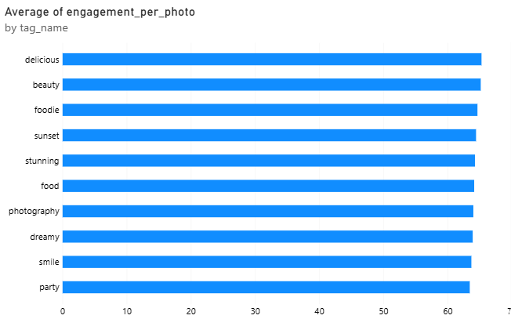
Analysis
The chart shows that #delicious has the highest average engagement per photo, followed closely by #beauty and #foodie. Hashtags such as #sunset, #stunning and #food also demonstrate strong engagement. This indicates that these content topics attract more interactions per photo.
Recommendation
Prioritize popular hashtags: Focus on #delicious, #beauty and #foodie in relevant campaigns.
Personalize content: Recommend posts based on users' hashtag interests.
Optimize marketing campaigns: Use high-performing hashtags to improve audience engagement.
Experiment with content: Test emerging hashtags to identify new engagement opportunities.

Slide 11
Strategic Recommendation
Re-engage inactive users: Send personalized notifications and reminders to encourage them to return to the platform.
Increase user participation: Encourage low-activity users to post more content, like photos, and comment on others' posts.
Personalize recommendations: Suggest relevant posts and popular hashtags based on users' interests.
Introduce engagement rewards: Offer badges, recognition, and incentives to motivate users to participate regularly.
Monitor user activity: Track engagement levels over time to evaluate whether these strategies improve participation and retention.

Slide 12
Conclusion
This project helped analyze user activity, engagement patterns, popular hashtags, and social connections using SQL. The analysis identified highly engaged users, popular content topics, and opportunities to improve user participation. It also revealed that 78.69% of users have low activity, while 21.31% are completely inactive, highlighting the need for re engagement strategies. Based on these insights, personalized recommendations, targeted marketing campaigns, and engagement incentives can help improve user activity and retention. Overall, this project demonstrates how data analysis can support informed decision-making, improve user engagement, and contribute to platform growth.
Thank you

